Slide 1

Specialist Domestic Abuse Courts: An Effective Model
Karen Senogles
Programme Manager – Criminal Justice and Courts

Slide 2
Criminal Justice Responses & Specialist Courts
18% of all offences recorded by the police in the year ending March 2021 were domestic-abuse related, an increase of 6% compared to the previous year
Only 21% of survivors will report to police.
Of cases reported, only 33% make it to court and the national average of convictions of all incidents reported to police is 6.5% for DA (but 76% of those charged)
The CPS domestic abuse-related charging rate in England and Wales decreased for the third year running to 70% in the year ending March 2021, compared with 76% in the year ending March 2018

Slide 3
What is a Specialist Domestic Abuse Court? (SDAC)
Combined approach to tackling DA
Whole system
Fundamental part of improving support to victims of DA
Why have an SDAC?
Focus on safety of victims
Allows for a more effective CJS response

Slide 4
History of SDACs
2005 national Government programme
National Steering Group
SDAC accreditation
Resource Manual
Recent decline in SDACs
Refreshed effort through DABPF
Multi-agency partnerships are key

Slide 5
12 Core Components of SDAC
Within CJS:
Identifying Cases
Listing of Cases
Court Facilities
Outside CJS:
MARACs
Children’s Services
Managing Perpetrators
Health & Housing
Partnership Working
IDVAs
Training
Equality / Diversity
Data Collection / Monitoring

Slide 6
Current Position
How many SDAC’s exist?
What is the impact of court closures?

Slide 7
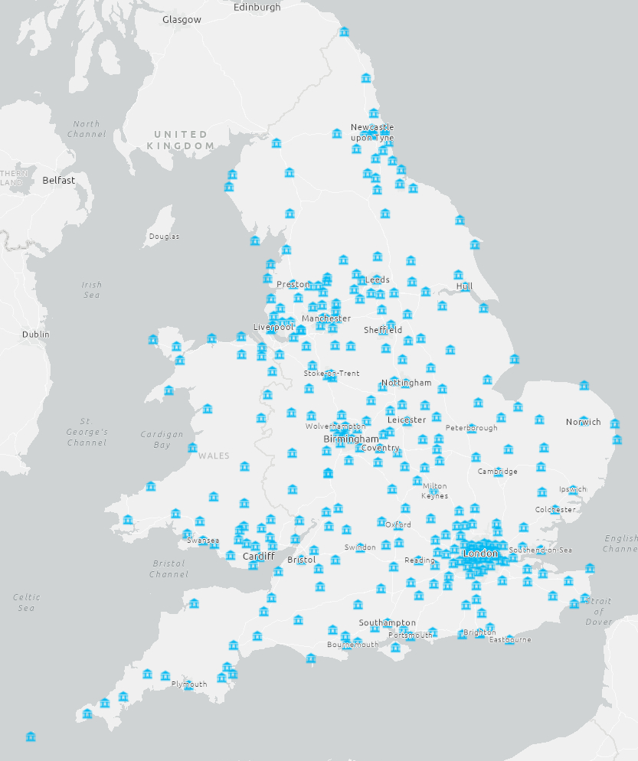
Magistrates’ Court Closures
2010
321 courts open

Slide 8
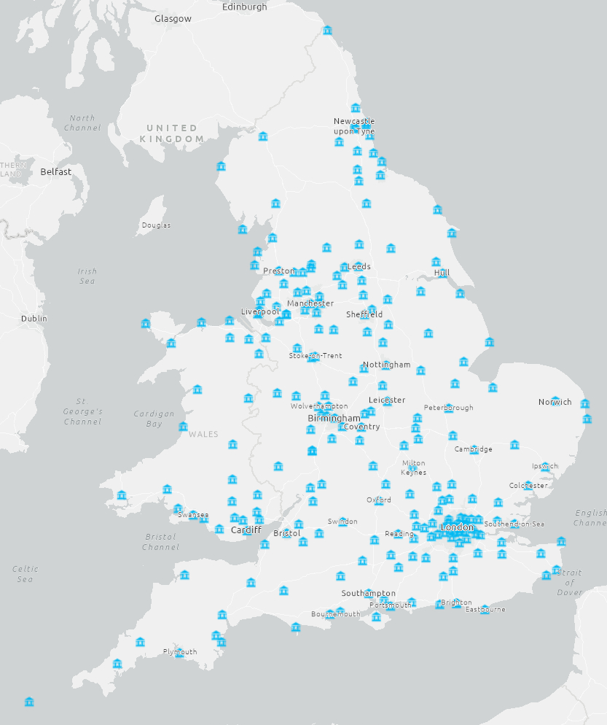
Magistrates’ Court Closures
2014
233 courts open

Slide 9

Magistrates’ Court Closures
2018
172 courts open

Slide 10
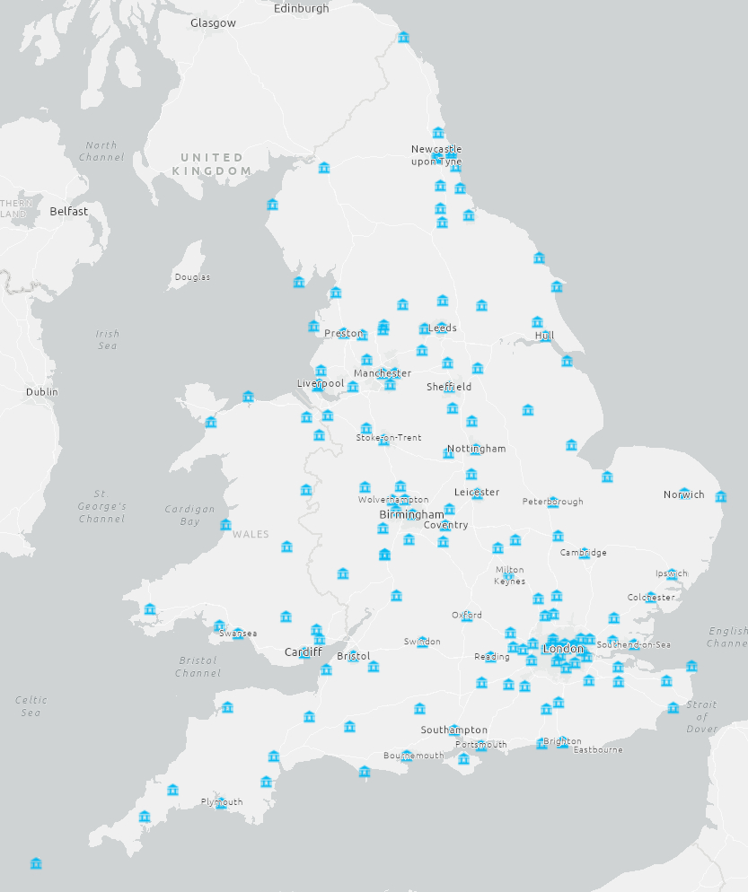
Magistrates’ Court Closures
2022
158 courts open

Slide 11
Magistrates’ Court Closures: the overall picture
2010
321 courts
2022
158 courts

Slide 12

Key components of an SDAC
Information sharing
Partnership Working
IDVAs
Measuring success, data collection
Training and Specialism
Coordination

Slide 13
DA Courts in West London
Standing Together coordinate both SDACs
Cluster Courts
Hammersmith (2002) & Westminster (2012)
All types of hearings (trials in other courts)
3 x London boroughs + City & BTP
Impact Project – co-location
CJ IDVAs
Focus on filebuild
Keeping the victim and safety at heart of processes

Slide 14
SDAC Operational Partnership
Essential to success of SDAC
Policies & protocols essential
Court Management Group/Steering Group
Court, CPS, Police (CSU & Witness Care), IDVA Service, Probation, Witness Service
Equal status of agencies
Examine issues & find solutions
E.g. applications to vary/remove restraining orders
Journey through CJS requires effective partnership

Slide 15
Operational principles of SDAC
A coordinated response to DA
Good practice by every participating agency
Monitoring against agreed aims
Inter agency accountability guided by protocols
Tracking of domestic violence offenders
IDVA provision
Co-ordination of the SDAC

Slide 16
Coordinators
Often behind the scenes
Key to identify issues and trends
Bring to the attention of all agencies
Developing resources & practical services
Ensure focus on victim safety
Negotiate protocols and procedures
Briefing key personnel
Share best practice locally & nationally

Slide 17
What the local data has told us about the SDAC
More defendants prosecuted
More convicted
Higher proportion early guilty plea
Fewer hearings per case
Length of cases reducing
More specialist IDVA support

Slide 18
Challenges
Training
Understanding of dynamics of DA
IDVA resource
Diverse funding structures
Coordination role
Agency restructures

Slide 19
Mentor Court Project
STADA have secured funding to develop Mentor Courts
London Mentor Court – existing SDACs at Westminster
Disseminate good practice
Showcase partnership approach

Slide 20
Mapping and Capacity Building
Within the Mentor Court Project is also a multi-agency national mapping exercise.
Building a picture of existing SDACs (or lack thereof) in England and Wales
Provide local areas with expert advice, guidance, and consultancy to help build capacity in setting up and managing an SDAC

Slide 21

What is happening in your area?

Slide 22
Contacts
Karen Senogles
k.senogles@standingtogether.org.uk
07927 550813
For Mentor Court visit enquiries:
criminal.justice@standingtogether.org.uk

