Slide 1


Emma Pickering – Senior Tech Abuse Manager
Tech Abuse
Photo copyright Julian Nieman for Refuge

Slide 2
Tech Abuse Service
National
7 Tech Leads 2 Economic Leads and a Tech Abuse Manager and Deputy Manager embedded within Refuge services across the country. 105 tech champions recruited and trained and based in Refuge services in order to be the local experts.
Local
The tech abuse team aim to cascade the specialist tech learning to staff across all services supporting the tech abuse learning culture at Refuge.
Internal The tech abuse lead works closely with the key worker providing expert advice on complex tech abuse cases to all the frontline specialists across the country.

Slide 3

Aims
Recognise ways in which abusers misuse technology
Know how to respond to victims of tech abuse and develop a safety plan
Understand how children and young people are impacted by tech abuse
Know where to look for further resources and support

Slide 4
Our Key Messages
The Tech Abuse service aims to achieve the following:
Stay one step ahead of the changes as technology is constantly evolving;
Empower women to use technology safely and avoid further compounding their isolation;
Promote a learning culture;
Avoid educating perpetrators; and
Lobby government and industry leads

Slide 5

What is Tech Abuse?
Perpetrators use technology to facilitate the following forms of abuse:
Physical;
Sexual;
Psychological;
Emotional;
Economic abuse

Slide 6
Physical
Destruction/removal
Monitoring tech use
Location tracking
Recording
Microchipping
Sexual
Sharing intimate images
Threats to share images
Online grooming
Deep fakes
Recording without consent

Slide 7
Psychological
Gaslighting
Online impersonation
Stalking and harassment
Constant calls and texts
IoT misuse
Economic
Fraudulent debts
Controlling resources
Enforcing spending limits
Limiting earning potential
Online banking

Slide 8
Emerging Trends Graph

Slide 9
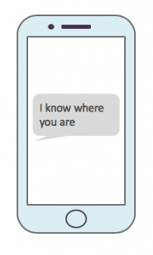
Tracking and surveillance
There are a number of ways in which this form of tech abuse can be facilitated:
Location settings
Linked devices
Access to accounts
Tracking applications
Spyware/Stalkerware
Physical trackers

Slide 10

Location settings
Various devices have location settings;
Mobile phones– iPhone and android phones
Smart home devices – Amazon Alexa's, Google nests, Ring doorbell etc.
Fitbit and Smart Watches
Smart TV’s
Apps downloaded onto devices used location settings
Find my iPhone
Google Maps
Snapchat and other social, media platforms
Amazon, EBay, online shopping and other accounts

Slide 11
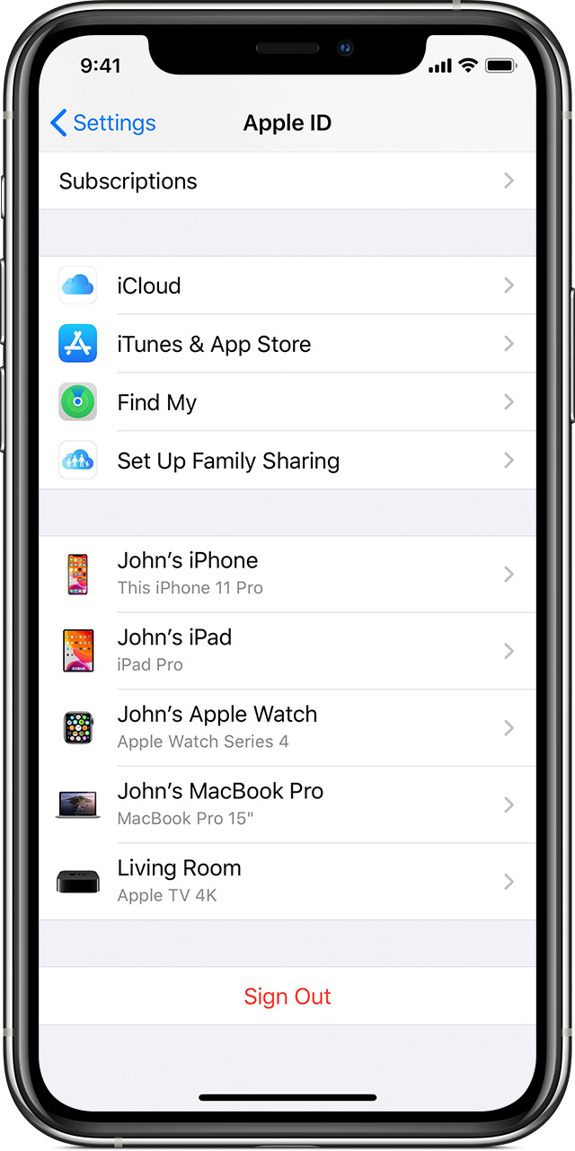
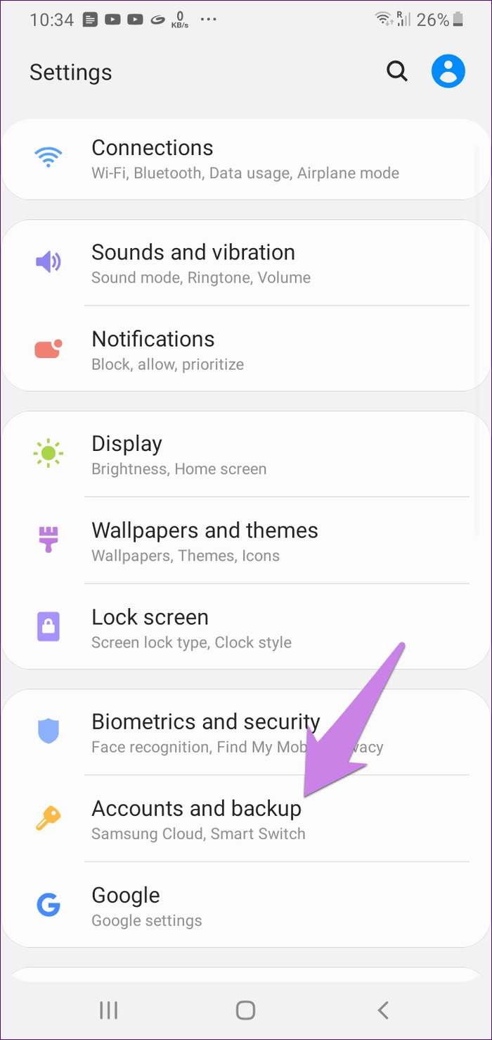
Linked Devices

Slide 12






Latest location tech

Slide 13

Spyware

Slide 14

Image Based Abuse
Image Based Abuse is when someone shares sexually intimate images or videos of another person without their consent, and with the aim of causing them distress or harm.
It refers to materials that are shared both online and offline, and includes uploading images to the internet and social media channels, sharing by text and email, and showing someone a physical or electronic image or video

Slide 15

The Naked Threat

Slide 16

Young People and Technology

Slide 17
Young People and Tech Statistics
44% of 8-11 year olds use social media
31% of 12-15 year olds have seen worrying or nasty content online
22% of 8-15 year olds use in-game chat with people they only know through the game (Ofcom Children and Parents – Media Use and Attitudes Report 2021)
Children aged 5-16 get over 6 hours of screen time per day on average (NHS Greater Glasgow and Clyde)

Slide 18
Why is it important?
Cyberbullying inquiry finds the mental health of young people is severely affected by online abuse
Parents using mobile phone trackers for children put them 'in danger', spy chief warns
Social media firms failing to protect young people, survey finds
TECH COMPANIES ARE FAILING TO PROTECT CHILDREN. ACADEMICS AND ONLINE CHILD ACTIVIST GROUPS SPEAK OUT
The children selling explicit videos on OnlyFans
Could gaming addiction ruin a generation?
Girl, 11, becomes one of UK's youngest victims of revenge porn as children are forced to move schools due to shocking picture sharing craze
Safeguarding in the digital age: Protection of children from online harms ‘an unmitigated disaster’
Calls to online child sexual abuse watchdog up 45%
Coronavirus: Fears over online grooming of children in lockdown

Slide 19





So called healthy relationships…
Young People and Tech
#relationshipgoals
Notes:
-

Slide 20

Risks to Young People
Online Grooming
Sextortion
Cyberstalking and harassment
Catfishing
Cyberbullying
Image based abuse
Radicalisation
Online Pornography
Self harm
Identity and Privacy Theft

Slide 21

Warning signs
Wanting to spend more and more time on the internet
Being secretive about who they are talking to online and what sites they visit
Switching screens when you come near the computer
Possessing items – electronic devices or phones they have not received from trusted adult
Using sexual language you wouldn’t expect them to know
Receiving persistent text messages and calls
Wiping all social media accounts
Having a number of skins on their device

Slide 22

Assessing for tech abuse

Slide 23
Assessing for tech abuse
What phone do you have? Who is the network provider?
What other devices do you have? (refer to checklist)
What devices do your children have?
What accounts and apps do you use?

Slide 24
Assessing for tech abuse
Do you have a car? Does it have a sat-nav (consider in-built ones too)?
Does anyone else know your passwords? Do you use the same password across multiple accounts?
What has been happening which leads you to believe your devices or accounts are compromised?
How "techy" is the perpetrator? What is your level of tech knowledge?

Slide 25
Top Tips
Change your WIFI password regularly, if you have a booster change this password as well
Use strong passwords on ALL accounts – try to use different passwords for each
Do not use identifiable pictures and information on your social media profiles
Do not link profiles and accounts
Complete image and Google search regularly to check what information about you is online
Do not use family sharing or link devices
Download an anti-virus to your devices
Check the settings within your home devices
Set two factor authentication on all accounts with alerts set to your mobile
Regularly update your device
Regularly review accounts and devices privacy and security settings – particularly after updates
Check your children’s accounts and devices as well. Consider setting parental controls on your router
Gather evidence of tech abuse where possible – screenshots/URLS

Slide 26
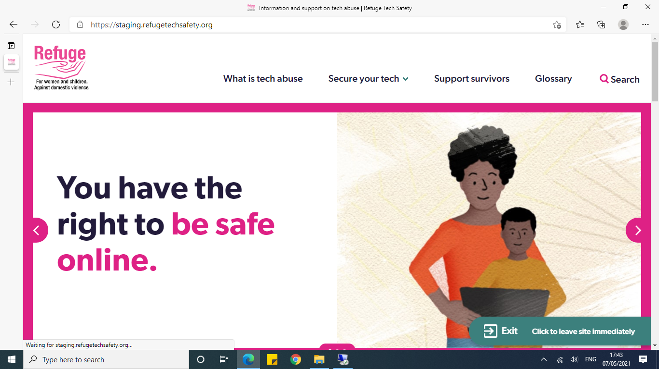
Tech safety website

Slide 27
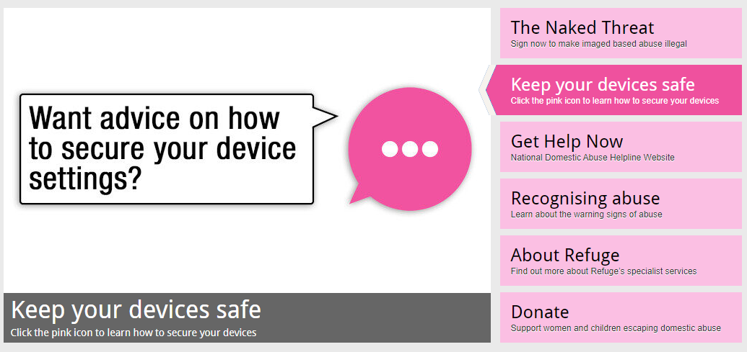
Multilingual Tech Safety Tool
English
Urdu
Polish
Spanish

Slide 28
Any questions?
Feedback!
Find resources and more information on our website:
Emma_Pickering@refuge.org.uk
www.refuge.org.uk
www.refuge.org.uk/our-work/forms-of-violence-and-abuse/tech-abuse/
www.refugetechsafety.org

