Slide 1
The Role of Housing
Charlotte Stenhouse
Operations Manager for Supported Housing and Domestic Abuse (Torus)

Slide 2
Who are Torus?
One of the biggest Providers of affordable homes in the North West
Around 40,000 homes and over 74,000 customers
More than just a landlord - Torus Support Network

Slide 3
Why is housing key?
Home is where perpetrators are most likely to cause harm and kill
Perpetrators use housing as a form of economic abuse and coercive control
Domestic abuse is a leading cause of homelessness amongst women
Emphasis on victim/survivors needing to leave to become safe

Slide 4
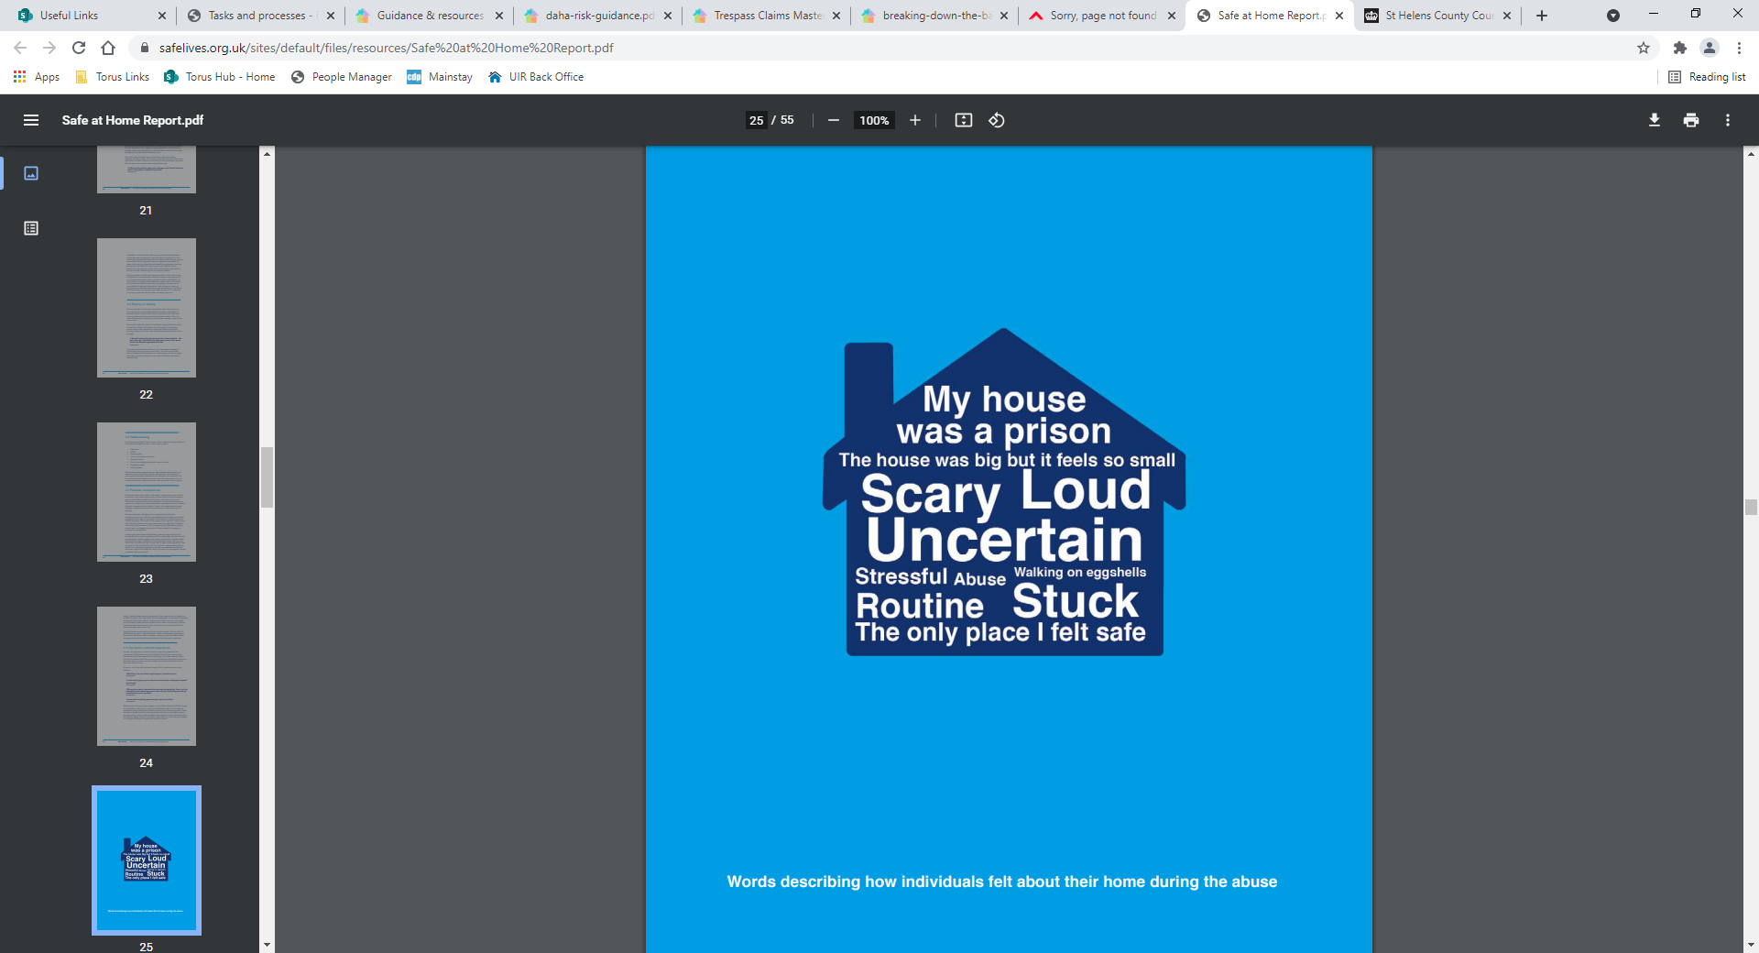
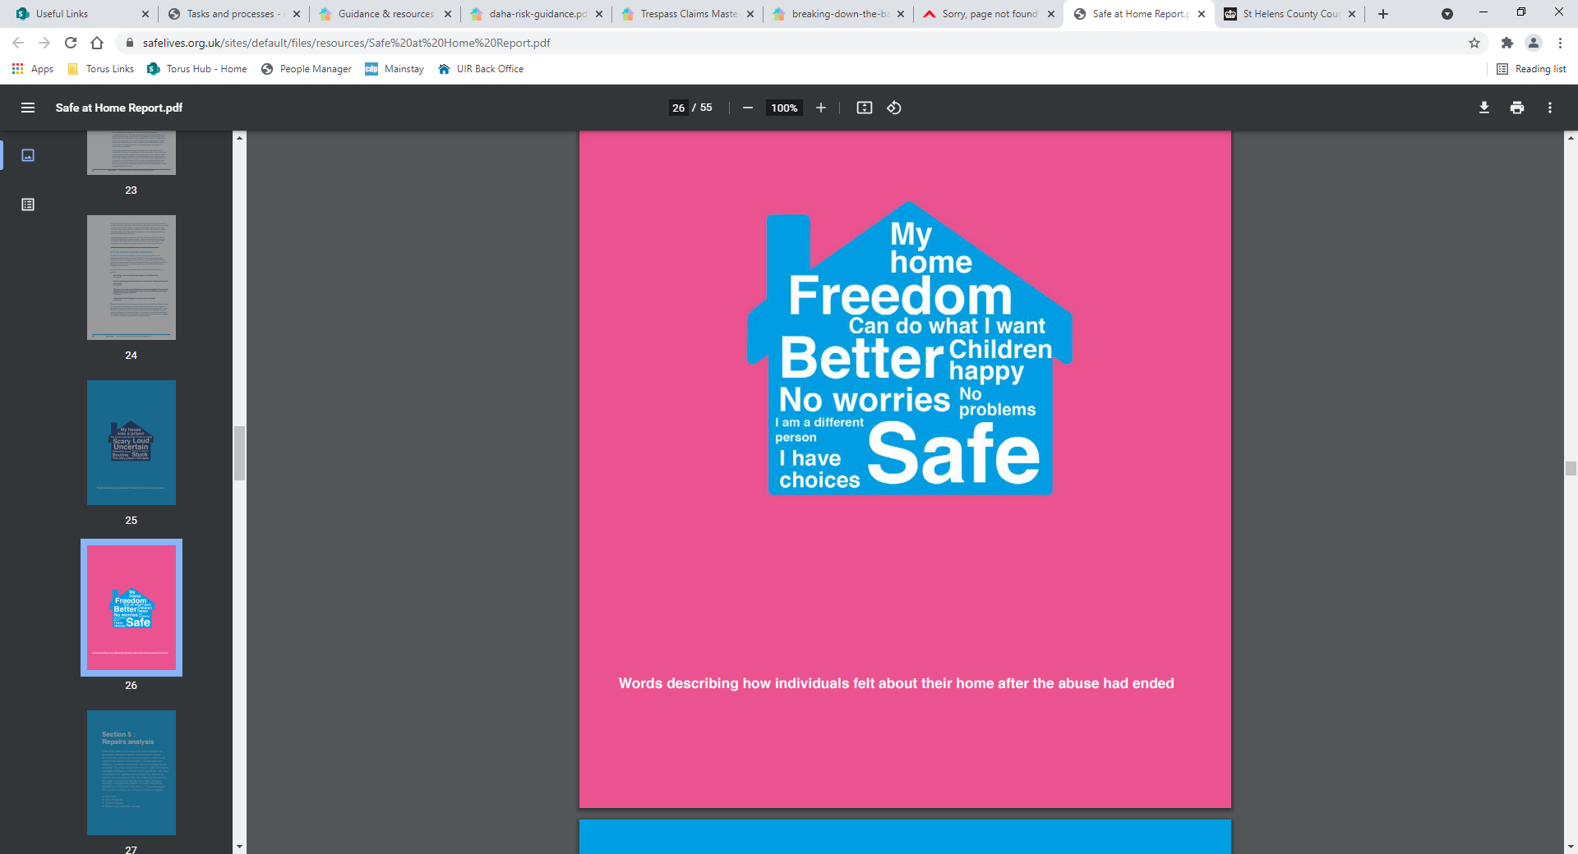
Safelives/Safe at Home Research

Slide 5
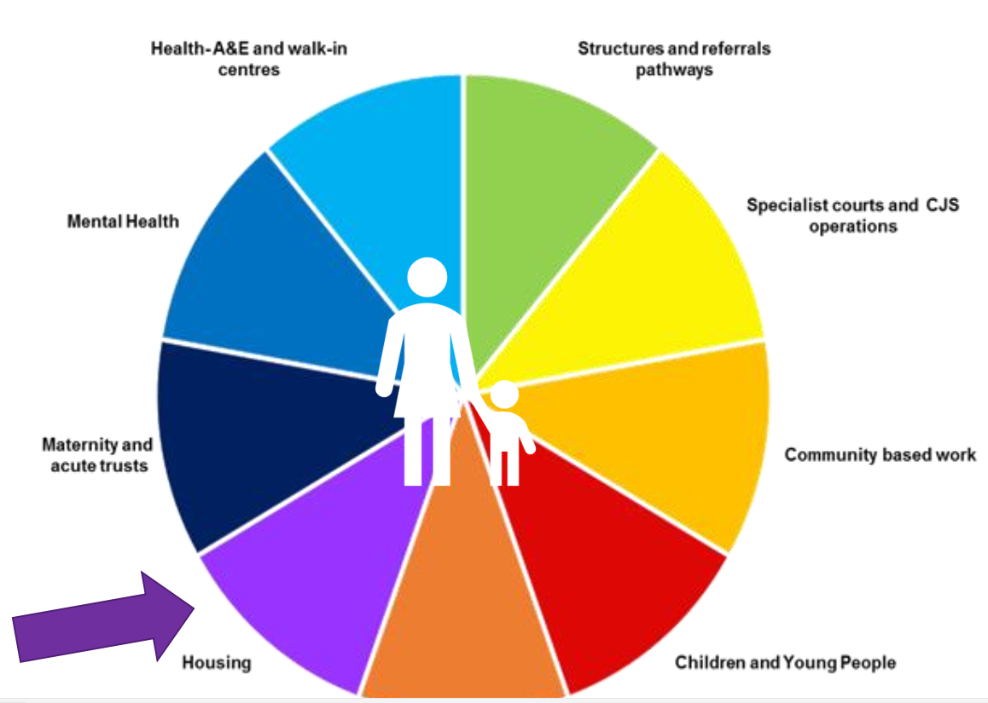
Coordinated Community Response

Slide 6
What role does housing have to play?
To identify victims before they reach a point of crisis
Provide a link to domestic abuse services who can offer specialist support
To support tenants to maintain their housing and hold perpetrators to account
To consider alternative, safe and secure accommodation
To share information with multi-agency professionals

Slide 7
Spotting the signs
Housing staff may identify signs of domestic abuse such as:
Punch holes in walls and doors
Broken locks, numerous lock change requests or lost keys
Kick marks in doors
Demeanour of the victim and their children;
Visible injuries
‘Anti social behaviour’ ie Noise complaints
Requests to remove someone off a tenancy
Multiple repairs i.e. windows, doors, damage etc

Slide 8

Always consider coercive control
What does your instinct say? Professional curiosity!
https://www.youtube.com/watch?v=RikpW5n7d5k

Slide 9
Disclosures: Creating a safe space
Discrection
Validation
Safe Contact
Pathways
Language Line
Alert Police
If a tenant discloses Domestic Abuse, you should aim to faciliate a safe space
You should validate the victim, reassure them that they are believed & help is available.
Ask the victim for their safest contact information – including preferred contact method, safe times, set up a code that staff can use
If a tenant presents & states they are in danger & need a Police response, perpetrator in close proximity or risk escalates– alert 999 immediately.
All housing staff should understand & be able to explain specialist DA support is available to tenants disclosing domestic abuse
If the tenants first language is not English, you should only use a professional translation service to discuss DA. It is unsafe to use family/friends/community members/children

Slide 10
ABC Respond
Escalation Procedure
ABC acts as a reporting mechanism for safeguarding or welfare concerns
Duty Manager able to process and respond to any immediate concerns
Allocate to a Neighbourhood Officer or Tenancy Sustainment Officer for ongoing support

Slide 11
Torus approach
Commissioned specialist Domestic Abuse Service St Helens
IDVA/Outreach Service
Refuge Accommodation
24/7 helpline and text service
Attendance at MARAC across key heartlands
Liverpool offer

Slide 12
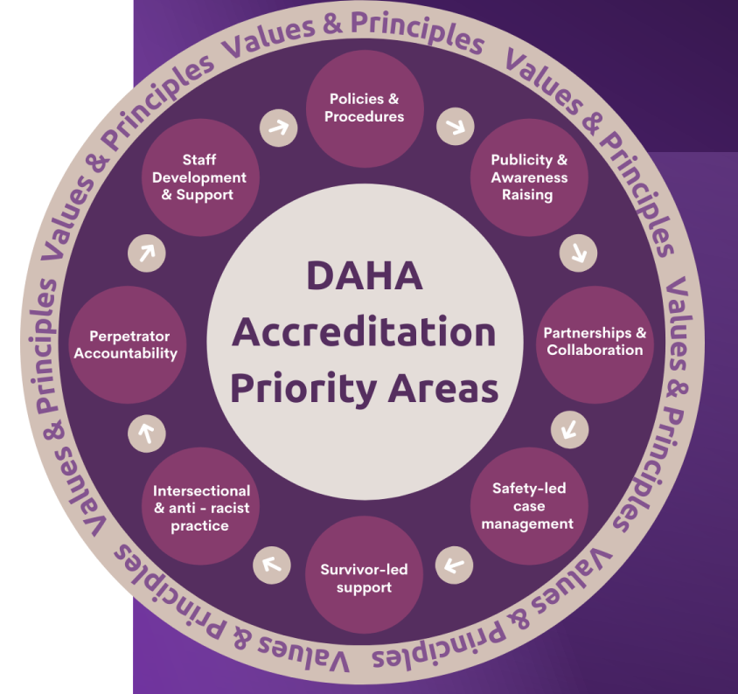

Domestic Abuse Housing Alliance (DAHA) – accreditation framework

Slide 13
Changing how we respond to victims housing needs
Change the narrative
Prevent homelessness due to domestic abuse AND provide safe
alternative accommodation
Consider victims specific needs
Work together across housing, domestic abuse, and other agencies
through a Coordinated Community Response

Slide 14

Thank you – any questions?

